Slide 1

.
WORKING PROGRESS
GROUP - 5

Slide 2
leader
Team members and roles
Sachin Maharjan- Scrum Master & Backend Developer,complete finisher
leader
Simona kattel - Product Owner & Frontend Lead,Coordinator
Aayushma Dhakal-Mobile Developer & Database Architect, specialist
Abhinav Sitaula-IoT Engineer & Systems Integrator,resource investigator
Bardan Thapa- UI/UX Designer, Documentation Lead & QA Engineer,plant
Pradeep Yadav-AI/ML Engineer & DevOps Lead , shaper

Slide 3
Our mission
We simplify retail management by providing smart, accessible tools for inventory, billing, and business insights.
INVO6

Slide 4
The problem
.
?
Customers:
Can’t track purchases
No app-based interaction
Businesses don’t know:
Future demand
Current trend
What stock is available?
What is running out?
Retail shops don’t know:
Which product sells most?
When is peak time?
Which items are not selling?
!

Slide 5
Our solution
Customers:
Customer app interface
Purchase tracking
Better engagement
Businesses :
AI/ML prediction model
Suggest restocking
Demand forecasting
Problem:
Retail shops :
Real-time inventory tracking system
Dashboard showing stock levels
Alerts for low stock

Slide 6
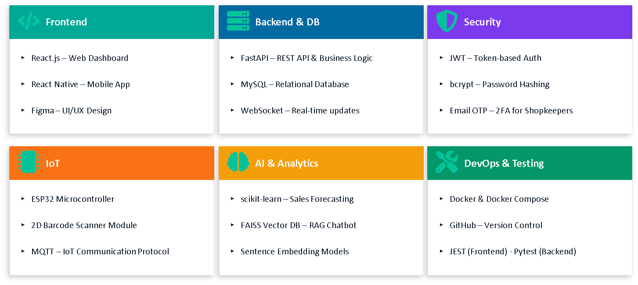
What is used

Slide 7

Sprint planning
Sprint metric 1
Sprint metric 2
Sprint metric 3
Sprint metric 4
improve styling (colors, spacing, responsiveness)
Make dashboard visually structured (charts, cards, layout fixes)
Add animations and better UX (hover, transitions)
Ensure all pages are fully responsive
Connect frontend with backend APIs.
Implement login system (JWT + authentication)
Setup backend server
Connect backend with MySQL database
Create API endpoints (products, users)
Implement full CRUD operations
Store and retrieve product & user data
Data validation and consistency
Implement forecasting model
Build chatbot (RAG-based)
Integrate AI APIs with backend
Complete IoT billing workflow, ESP32 and MQTT communication
Full system testing (frontend + backend + AI + IoT)
Final deployment (Docker)
Documentation and report writing
Prepare dataset for sales forecasting
Setup React project (Vite, Tailwind, routing)
Create basic components (Navbar, Sidebar, Forms)
Prepare frontend folder structure
Setup pages (Login, Dashboard, Inventory, Billing - basic layout only)
Wireframe design

Slide 8
Working Status
FRONTEND PROGRESS
30%
BACKEND PROGRESS
10%
DATABASE PROGRESS
50%
AI PROGRESS
5%

Slide 9
PLANNING,INITIATION , EXECUTION
planning
Initiation
Execution
Belbin analysis
Skill Audit
Communication tools - tello, discord etc
ERD
LOGO
Wireframe
Use case diagram
Project charter
Project title
Risk register
Team contract

Slide 10

Logo

Slide 11
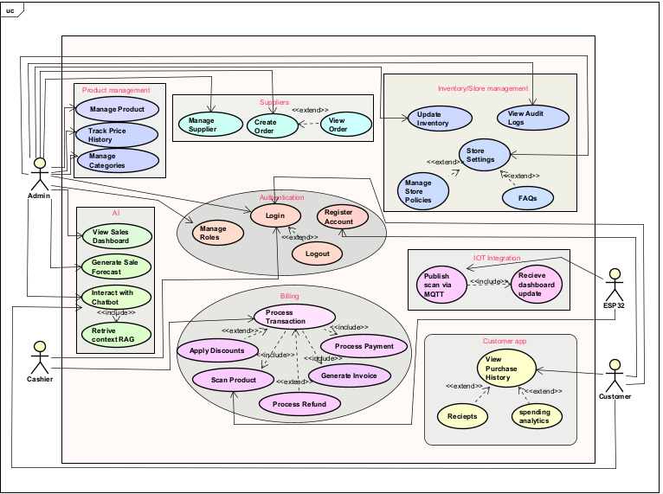
USE CASE DIAGRAM

Slide 12
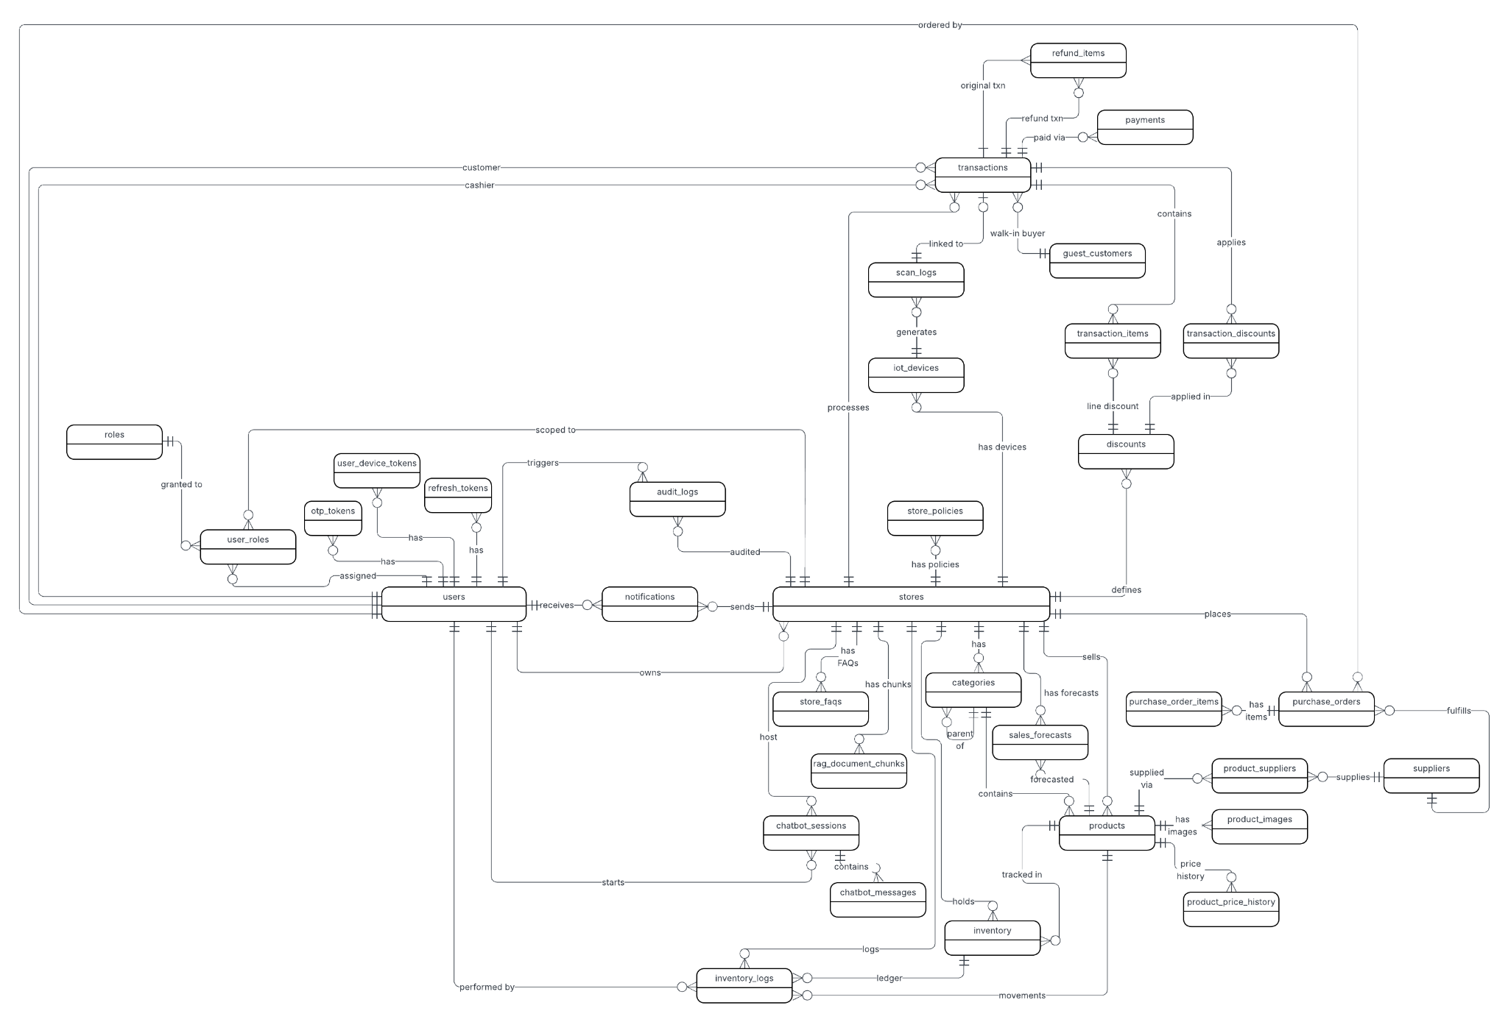
ERD Diagram

Slide 13
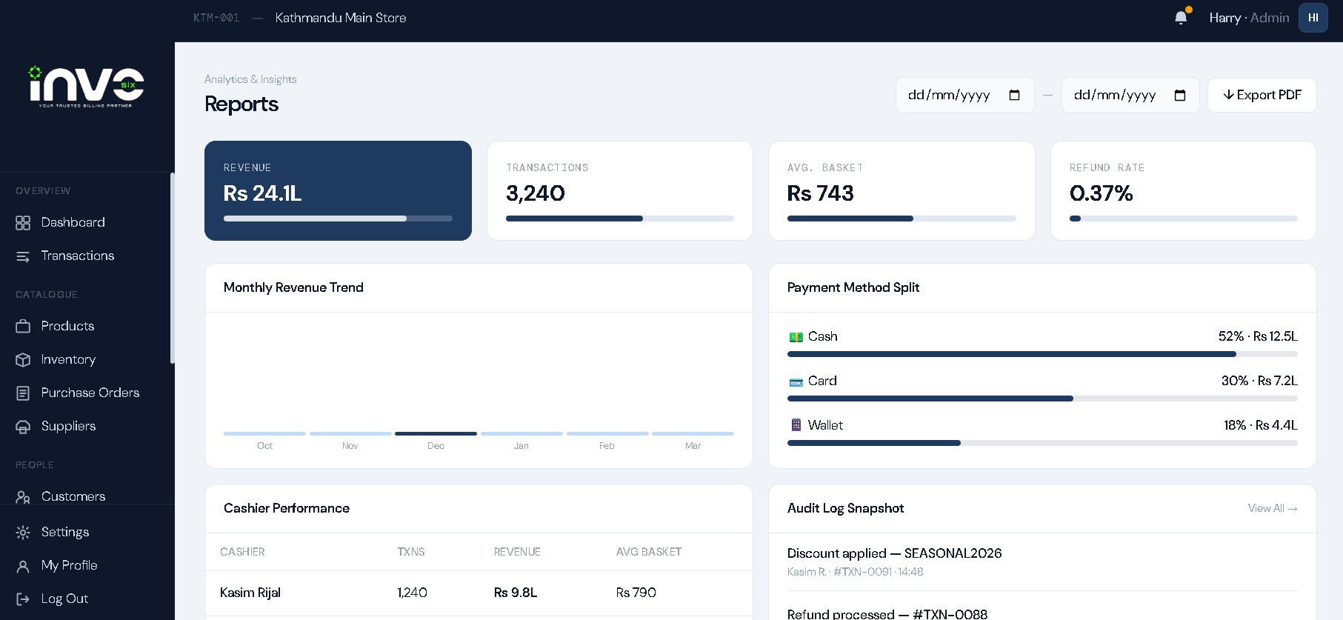
WEBSITE

Slide 14
WHAT’S NEXT
Setup backend server
Connect backend with MySQL database
Create API endpoints (products, users)
Implement full CRUD operations
Store and retrieve product & user data
Data validation and consistency

Slide 15
Thank you!

